Slide 1
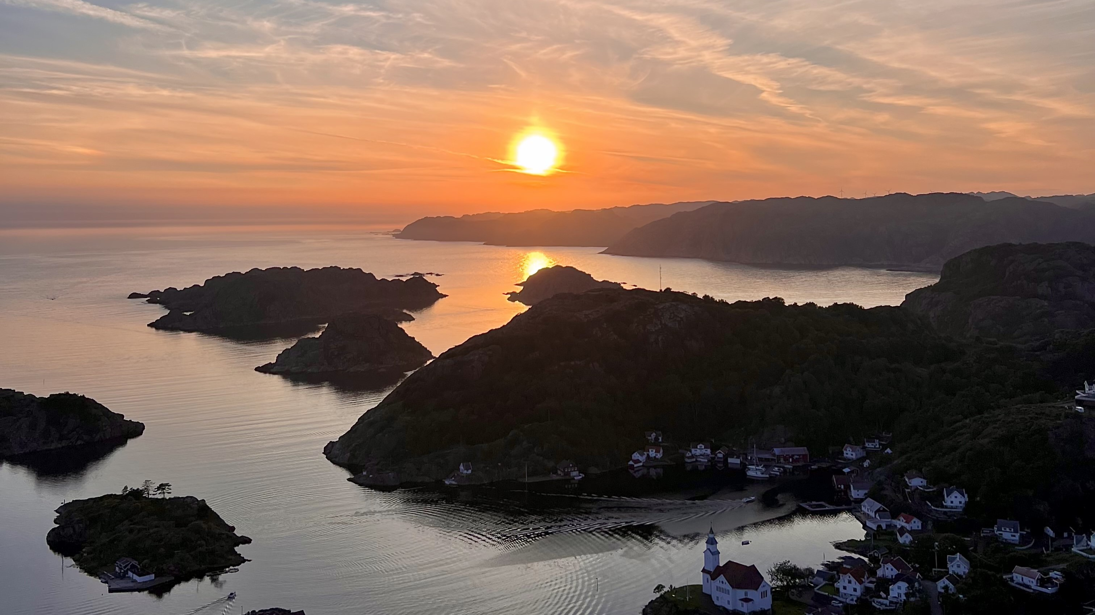

Allocation and Impact Report for Flekkefjord Sparebank Green Portfolio
Portfolio date | 31.12.2025

Slide 2
Alloction Report
Portfolio based green bond report according to the Green Finance Framework
Portfolio date 31.12.25
Eligible Project Category (a) | Signed Amount (b) | Green Bond Outstanding (c) | Allocation (d) | Issued Amount (e)
Flekkefjord Sparebank (Covered and Senior Bonds) | NOK |  | % | NOK
Green residential buildings in Norway | 1.600.000.000 | FRN Flekkefjord SpB Green Senior Bond 25/30 (NO0013582601) | 18,75 % | 300.000.000
 |  | FRN Flekkefjord SpB Green Senior Bond 25/28 (NO0013484733) | 25 % | 400.000.000
 |  | FRN Flekkefjord SpB Green Covered Bond 24/27 (NO0013311977) | 25 % | 400.000.000
 |  | FRN Flekkefjord SpB Green Senior Bond 23/28 (NO0013019042) | 25 % | 400.000.000
Total | 1.600.000.000 |  | 93,75 % | 1.500.000.000
Eligible category. The other categories defined in the Green Finance Framework are non-active
Signed amount represents the amount legally committed by the issuer for the portfolio components eligible for Green Bond financing
Outstanding bond issued under the green bond programme
Percentage of Eligible Green Project portfolio allocated to net proceeds of green funding
The issued amount in NOK represents the hedged amount in NOK, 100 % is hedged until maturity

Slide 3
Impact Report
Portfolio based green bond report according to the Green Finance Framework
Portfolio date 31.12.25
Eligible Project Category (a) | Signed Amount (b) | Annual emission avoidance (c)
Residential green building | NOK | tCO2
Green residential buildings (TEK10/17) | 1.600.000.000 | 3.682
Eligible category. The other categories defined in the Green Finance Framework are non-active
Signed amount represents the amount legally committed by the issuer for the portfolio components eligible for Green Bond financing
(c) Emission avoidance due to for energy savings

Slide 4
Methods for Calculation
(c) Annual emission savings due to energy savings
The method used to calculate annual emission savings are described below.
The average m2 house is approximately 125 m2. We have estimated that 1 341 loans qualify for the Green Loan Portofolio. The average loan is estimated to 2,4 MNOK. This gives a total of 167 625 m2.
Multiconsult has estimated the energy consumption for non green buildings at 250 kWh/m2/year, and buildings that qualifies for TEK10/17 to 115 kWh/m2/year.
The emission factor is set at 191 gCO2/kWh/year by NPSI (NPSI Position Paper on Green Bonds Impact Reporting 2024).
This gives an annual emission avoidance of 3 682 tCO2.
Annual emission savings = (Baseline energy usage – Average energy demand) x Emission factor x Estimated financed area

